Slide 1
How to type Chinese simplified character in your computer?

Slide 2
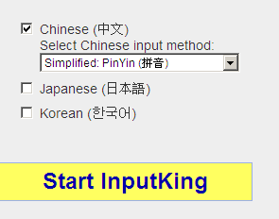
Please visit at http://inputking.com/ and select Chinese simplified, then click start inputKing

Slide 3
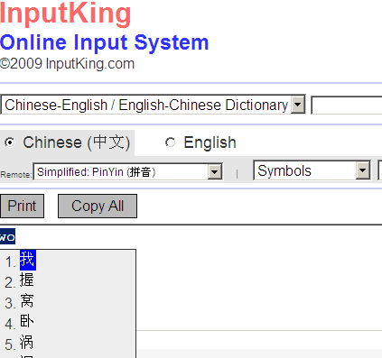
In this area, you start to type “wo” then you will see it comes out with many options to select. [ I = 我 (wo)] You will select number 1.

Slide 4
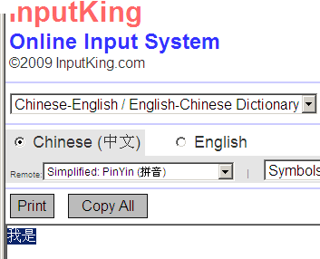
You follow slides 3 to type Chinese characters until you complete your typing. Then you bold the area to copy and paste in your word document and save as well. Then, you just upload this file in your dropbox.

